Slide 1
Chapter 5
The vector space R^{n}
Notes:
The basis theory of finite dimensional vector space such concepts as subspaces, spanning sets, linear independence and dimension.
The pace is slow because this is the first acquaintance may students have had with an abstract system.

Slide 2
Contents
5.1 Subspaces and Spanning sets
5.2 Independence and Dimension
5.3 Orthogonality
5.4 Rank of a Matrix

Slide 3




Subspace of R^{n}
•
Definition of subspace of R^{n}.
Let Ø≠U be a subset of R^{n}
U is called a subspace of R^{n} if:
◆ S₁. The zero vector 0 is in U
❖ S₂. If X,Y are in U then X+Y is in U
⬥ S₃. If X is in U then aX is in U for all real number a.
Ex1. U={(a,a,0)|aR} is a subspace of R³
◆ the zero vector of R³, (0,0,0)U
❖ (a,a,0), (b,b,0)U(a,a,0)+(b,b,0)=(a+b,a+b,0)U
⬥ If (a,a,0) U and k R, then k(a,a,0)=(ka,ka,0)U
Ex2. U={(a,b,1): a,b R} is not a subspace of R³
◆ (0,0,0)U  U is not a subspace
Ex3. U={(a,|a|,0)|a R} is not a subspace of R³
❖ (-1,|-1|,0), (1,|1|,0)U but (0,2,0) U  U is not a subspace
•
• •
•
•
vector
zero vector
•
aX
• •
•
•
•
•
•
X+Y
Y
X

Slide 4
Examples- do your self
V={[0 a 0]^{T} in ○³: a Z}
U={[a 7 3a]^{T} in ○³: aR}
W={[5a b a-b]^{T} in ○³: a,bR}
Q={[a b |a+b|]^{T}: a ○}
H={[a b ab]^{T}: a,b ○}
P={(x,y,z)| x-2y+z=0 and 2x-y+3z=0}. P is called the solution space of the system x-2y+z=0 and 2x-y+3z=0.
Nhận xét: các trường hợp sau không là không gian vector con
có thành phần khác không
có hệ số bậc cao hoặc tích
có dấu | |
có a và a+1 chẳng hạn

Slide 5
Note
A subspace either has only one or infinite many vectors
Example, {0} has only vector
If a subspace U has nonzero vector X then aX is also in U (by S3). Then U has infinite many vector

Slide 6

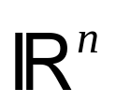
Null space and image space of a matrix
A is an mxn matrix, if X is nx1 matrix then AX is mx1 matrix
nullA = {X in R^{n}: AX=0}
imA = {AX: X is in R^{n}}
A
nullA
•
imA
zero vector
nullA ={X R^{n}:AX=0} is a subspace of R^{n}:
◆ A.0=00nullA
❖ X,Y nullA AX=0, AY=0 A(X+Y)=AX+AY=0 (X+Y) nullA
⬥ X nullA, a R  AX=0  A(aX)=a(AX)=0  aXnullA
imA ={AX:X  R^{n}}is a subspace of R^{m}:
◆ 0=A.00imA
❖ AX,AY imA AX+AY=A(X+Y)=AZ
AX+AY imA
⬥ AX imA, a R  a(AX)=A(aX)=AZ  a(AX)imA

Slide 7
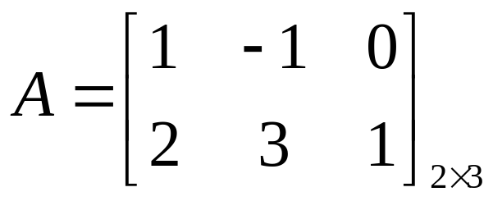
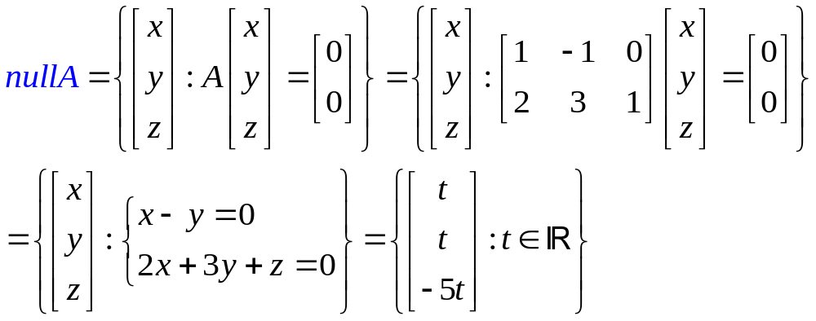
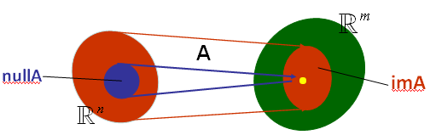
Null space nullA={X:AX=0}
For example,

Slide 8
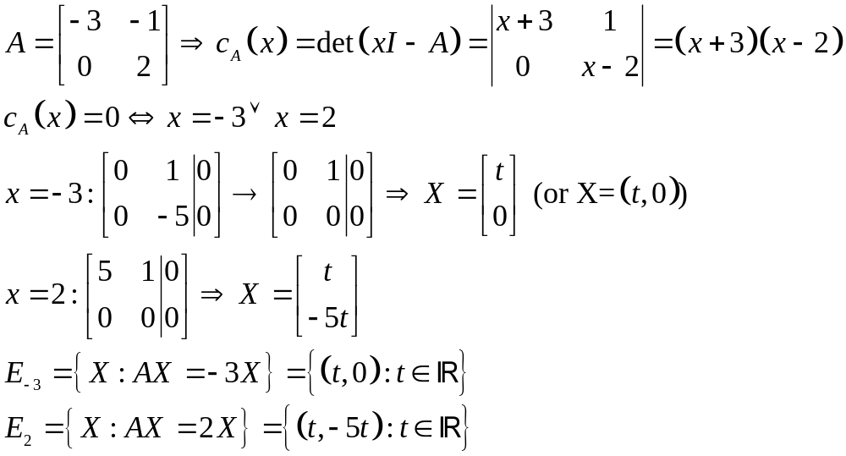
Eigenspaces (không gian riêng)
Suppose A is an nxn matrix and λ is an eigenvalue of A
E_{λ}(A)={X: AX=λX} is an subspace of R^{n}
For example,
Các không gian riêng
ứng với GTR

Slide 9
Spanning sets (hệ sinh)
Y=k₁X₁+k₂X₂+…+k_{n}X_{n} is called a linear combination of the vectors X₁,X₂,…,X_{n}
The set of all linear combinations of the the vectors X₁,X₂,…,X_{n} is called the span of these vectors, denoted by span{X₁,X₂,…,X_{n} }.
This means, span{X₁,X₂,…,X_{n}} = {k₁X₁+k₂X₂+…+k_{n}X_{n} :k_{i}R is arbitrary}
span{X₁,X₂,…,X_{n}} is a subspace of R^{n}.
For example, span{(1,0,1),(0,1,1)}={a(1,0,1)+b(0,1,1) :a,bR}.
And we have (1,2,3)span{(1,0,1),(0,1,1)} because (1,2,3)= 1(1,0,1)+ 2(0,1,1).
(2,3,2)span{(1,0,1),(0,1,1)} because (2,3,2)≠a(1,0,1)+b(0,1,1) for all a,b.
Nếu U=span{X,Y} ta nói U là KG được sinh ra bởi {X,Y} hay hệ {X,Y} sinh ra KG U. Khi đó, U chứa tất cả các vector có dạng aX+bY với a, b là các số thực tùy ý.
vector Zspan{X,Y} khi và chỉ khi có các số thực a,b sao cho Z=aX+bY hay hệ pt Z=aX+bY có nghiệm a,b.
Ta cũng nói Z là một tổ hợp tuyến tính (linear combination) của X,Y khi Z=aX+bY hay Zspan{X,Y}.

Slide 10
Examples
If x=(1,3,-5) is expressed as a linear combination of the vectors v₁ = (1, 1, 1); v₂ =(1,1,-1); v₃ = (1, 0, 2); then the coefficient of v₃ is:
A. 2 B. 3 C. -2  D. 1 E. 0
x is expressed as a linear combination of v₁, v₂, v₃ means x=av₁+bv₂+cv₃ for some a,b,c and c is called the coefficient of v₃.
the system is
a + b + c = 1  a =1
a + b = 3  b =2
a – b +2c =-5  c =-2
1 | 1 | 1 | 1
1 | 1 | 0 | 3
1 | -1 | 2 | -5
1 | 1 | 1 | 1
0 | 0 | -1 | 2
0 | -2 | 1 | -6
1 | 1 | 1 | 1
0 | -2 | 1 | -6
0 | 0 | -1 | 2
Which of the vectors below is a linear combination of u=(1,1,2); v=(2,3,5)?
A. (0,1,1)  B. (1,1,0) C. (1,1,1) D. (1,0,1)  E. (0,0,1)
Có thể giải bằng biến đổi sơ cấp trên ma trận chứa các vector cột như sau:
u | v | A | B | C | D | E
◆ | 2 | 0 | 1 | 1 | 1 | 0
1 | 3 | 1 | 1 | 1 | 0 | 0
2 | 5 | 1 | 0 | 1 | 1 | 1
u | v | A | B | C | D | E
◆ | -2 | 0 | 1 | 1 | 1 | 0
0 | ◆ | 1 | 0 | 0 | -1 | 0
0 | 1 | 1 | -2 | -1 | -1 | 1
u | v | A | B | C | D | E
◆ | -2 | 0 | 1 | 1 | 1 | 0
0 | ◆ | 1 | 0 | 0 | -1 | 0
0 | 0 | 0 | -2 | -1 | 0 | 1
Notes:
Lưu ý A, D là các tổ hợp tuyến tính (linear combination) của u, v bởi vì các hệ pt tương ứng A=au+bv, D=au+bv có nghiệm a,b.
BT: 1
2 p.235

Slide 11



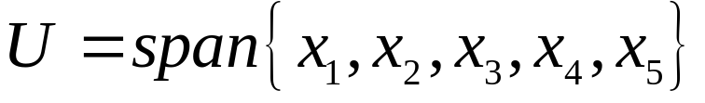
Theorem
U=span{X₁,X₂,…,X_{n}} is in R^{n} and U is a subspace of R^{n}
If W is a subspace of R^{n} such that X_{i} are in W then
•
• •
•
•

Slide 12
Linear Independence (sự độc lập tuyến tính)
A set of vectors in R^{m} {X₁,X₂,…,X_{n} } is called linearly independent (độc lập tuyến tính)
if t₁X₁+t₂X₂+…+t_{n}X_{n}=0  t₁=t₂=…=t_{n}=0 only
numbers in R
vectors in R^{m}
Ex1. The set {[1 -1]^{T}, [2 3]^{T}}R² is called linearly independent since t₁[1 -]^{T} + t₂[2 3]^{T} = [0 0]^{T} follows t₁=t₂=0.
Ex2. A set of vectors that containing zero vector never linearly independent.
Ex3. The set {(0,1,1), (1,-1,0), (1,0,1)} is not linearly independent because the system t₁(0,1,1)+t₂(1,-1,0)+t₃(1,0,1)=(0,0,0) has one solution t₁=-1, t₂=-1, t₃=1

Slide 13
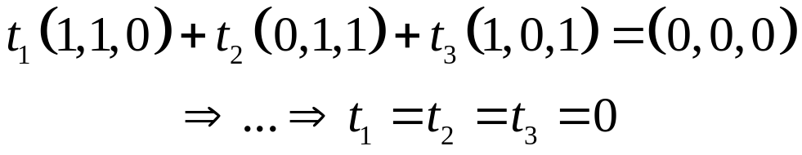
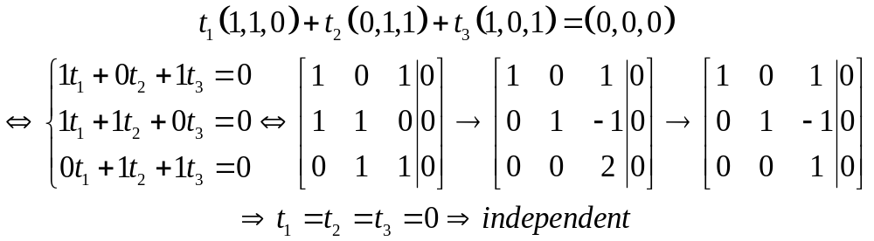
Examples
Show that {(1,1,0);(0,1,1);(1,0,1)} is linearly independent in R³
Fast way to determine a set of vectors is independent or not:
independent ⇔ Number of leading 1s = member of vectors
More ex. {(1,0,-2), (2,1,0), (0,1,5), (-1,1,0)} is not linearly independent (number of leading 1s = member of vectors)
1 | 2 | 0 | -1
0 | 1 | 1 | 1
-2 | 0 | 5 | 0
1 | 2 | 0 | -1
0 | 1 | 1 | 1
0 | 4 | 5 | 2
1 | 2 | 0 | -1
0 | 1 | 1 | 1
0 | 0 | 1 | -2

Slide 14
Examples – do your self
Determine whether each the following sets is linearly independent or linearly dependent.
{(-1,2,0)}
{(0,0,0); (1,2,3); (-3,0,1)}
{(1,1,-1); (-1,1,1); (1,-1,1)}
{(-2,3,4,1); (4,-1,5,0); (-2,1,0,3)}
{(1,1,0); (-2,3,1); (5,0,1); (-1,0,2)}
{X-Y+Z,3X+Z,X+Y-Z}, where {X,Y,Z} is an independent set of vectors. (see below)
1 | 3 | 1
-1 | 0 | 1
1 | 1 | -1
◆ | 3 | 1
0 | 3 | 2
0 | -2 | -2
◆ | 3 | 1
0 | ◆ | 1
0 | 3 | 2
◆ | 3 | 1
0 | ◆ | 1
0 | 0 | -1
◆ | 3 | 1
0 | ◆ | 1
0 | 0 | ◆
independent

Slide 15
Fundamental Theorem
Theorem. Let U be a subspace of R^{n} is spanned by m vectors, if U contains k linearly independent vectors, then k≤m
This implies if k>m, then the set of k vectors is always linear dependence.
For example, Let U be the space spanned by {(1,0,1), (0,-1,1)} and S={(1,0,1), (0,-1,1), (2,-1,3)} U. Then, S is not linearly independent (m=2, k=3).

Slide 16
Basis and dimension (cơ sở và chiều của KG)
Definition of basis: Suppose U is a subspace of R^{n}, a set {X₁,X₂,…,X_{k}} is called a basis of U if U=span{X₁,X₂,…,X_{k}} and {X₁,X₂,…,X_{k}} is linear independence
Ex1. Let U={(a,-a)|aR}. Then U is a subspace of R². Consider the set B={(1,-1)}. B is linearly independent and U={(a,-a):aR}={a(1,-1): aR } =span{(1,-1)}. So, B is a basis of U.
Note that B’={(-1,1)} is also a basis of U.
But {(1,1)} is not a basis of U because U can not be spanned by {(1,1)}
Ex2. Given that V=span{(1,1,1), (1,-1,0), (0,2,1)}. Then, B={(1,1,1), (1,-1,0), (0,2,1)} is not linearly independent, because (0,2,1)=(1,1,1) – (1,-1,0)B is not a basis of V.
Consider B’={(1,1,1), (1,-1,0)}. B’ is linearly independent and all vectors in V are spanned by B’ because a(1,1,1)+ b(1,-1,0)+ c(0,2,1) =a(1,1,1)+ b(1,-1,0)+ c(1,1,1) –c(1,-1,0) = (a+c)(1,1,1)+(b-c)(1,-1,0). So, B’ is a basis of V.

Slide 17
Some important theorems
Theorem 1. The following are equivalence for an nxn matrix A.
◆ A is invertible.
❖ the columns of A are linearly independent.
⬥ the columns of A span R^{n}.
 the rows of A are linearly independent.
 the rows of A span the set of all 1xn rows.
Theorem 2. (Invariance theorem). If {a₁,a₂,..,a_{m}} and {b₁,b₂,…,b_{k}} are bases of a subspace U of R^{n,} then m=k. In this case, m=k is called dimension of U and we write dimU=m.
Ex1. Let U={(a,-a)|aR} be a subspace of R². Then, B={(1,-1)} is a basis of U and B’={(-1,1)} is also a basis of U. In this case, dimU=1.
Ex2. {(1,0), (0,1)} is a basis of R² and {(1,-2), (2,0)} is also a basis of R². But {(1,0), (-1,1), (1,1)} is not a basis of R². We have dimR²=2.
The basis {(1,0), (0,1)} is called standard basis of R².
Ex3. Which of the following is a basis of R³?
◆ {(1,0,1), (0,0,1)}
❖ {(2,1,0), (-1,0,1), (1,0,1), (0,-1,1)}
⬥ {(0,1), (1,0)}
 None of the others
Nhận xét: trong R³, mọi tập có 3 vector độc lập đều là cơ sở.

Slide 18
Some important theorems
Theorem 3. Let U≠0 be a subspace of R^{n}. Then:
◆ U has a basis and dimUn.
❖ Any independent set of U can be enlarged (by adding vectors) to a basis of U.
⬥ If B spans U, then B can be cut down (by deleting vectors) to a basis of U.
Ex1. Let U=span{(1,1,1), (1,0,1), (1,-2,1)} be a subspace of R³. This means, B= {(1,1,1), (1,0,1), (1,-2,1)} spans U.
◆ U has a basis and dimU3,
⬥  B can be cut down to a basis of U: {(1,0,1), (1,1,1)} is a basis of U, dimU=2
❖ construct a basis for U: {(1,0,1)} {(1,0,1), (1,1,1)}.
Theorem 4. Let U be a subspace of R^{n} and B={X₁,X₂,…,X_{m}}U, where dimU=m. Then B is independent if and only if B spans U.
Theorem 5. Let UV be subspaces of R^{n}. Then:
◆ dimU  dimV.
❖ If dimU=dimV, then U=V.
1 | 1 | 1
1 | 0 | -2
1 | 1 | 1
1 | 1 | 1
0 | -1 | -3
0 | 0 | 0
1 | 1 | 1
0 | 1 | 3
0 | 0 | 0
Cũng có thể chọn 2 vector 1 và 3, hoặc 2 và 3 làm cơ sở

Slide 19
Exercises
Determine whether U is a subspace of R³.
U={[0 a b]^{T}: a,b  R} 
U={[0 1 s]^{T}:s  R}
U={[a b a+1] ^{T}:a,b  R}
U={[a b a²]^{T}: a, b  R}
Nhận xét: không là subspace khi
có hằng số khác 0
có hai hệ số chênh lệch 1 hằng số
có bậc lớn hơn 1
1 | 0 | 2
0 | 1 | m
1 | 1 | 1
◆ | 0 | 2
0 | 1 | m
0 | 1 | -1
Find all m such that the set {(2,m,1),(1,0,1),(0,1,1)} is linearly independent.
m≠-1 
m=-1 only
m=0 only
m≠0
None of the others
Independent ⇔ số  = số vector
◆ | 0 | 2
0 | ◆ | m
0 | 0 | -1-m
A basis for the subspace U={[a b a-b]^{T}: a,b R} is…
a. {[1 0 1]^{T}, [0 1 -1]^{T}} 
b. {[1 1 0]^{T}}
c. {[1 0 1]^{T}, [-1 0 -1]^{T}, [0 1 -1]^{T}}
d. None of the others.
Nhận xét:
U phụ thuộc 2 tham số nên dimU=2 và mọi cơ sở đều phải có đúng 2 vector độc lập tuyến tínhchỉ có thể là a hoặc d.
kiểm tra a: độc lập và sinh ra U

Slide 20
Exercises
The dimension of the subspace U=span{(-2, 0, 3), (1, 2, -1),(-2, 8, 5),(-1, 2, 2)} is…
a. 2 
b. 4
c. 3
d. 1
không thể là b vì dimUdimR³=3
kiểm tra bằng biến đổi sơ cấp
1 | -2 | -1 | -2
2 | 8 | 2 | 0
-1 | 5 | 2 | 3
◆ | -2 | -1 | -2
0 | 12 | 4 | 4
0 | 3 | 1 | 1
◆ | -2 | -1 | -2
0 | ◆ | 1/3 | 1/3
0 | 0 | 0 | 0
}có đúng hai 
Let u and v be vectors in R³ and w  span{u,v}. Then …
a. {u,v,w} is linearly dependent. 
b. {u,v,w} is linearly independent.
c. {u,v,w} is a basis of R³
d. the subspace is spanned by {u,v,w} has the dimension 3.
w  span{u,v} means w=au+bv {u,v,w} is not independent
lưu ý cũng không có gì chắc chắn {u,v} độc lập nên dimU2
Let {u,v,w,z} be independent. Then …. is also independent.
a. {u,v+w,z} 
b. {u,v,v-z-u,z}
c. {u+v,u-w,z, v+z+w}
d. {u,v,w,u-v+w}
1 | 1 | 0 | 0
1 | 0 | 0 | 1
0 | -1 | 0 | 1
0 | 0 | 1 | 1
◆ | 1 | 0 | 0
0 | -1 | 0 | 1
0 | -1 | 0 | 1
0 | 0 | 1 | 1
◆ | 1 | 0 | 0
0 | ◆ | 0 | -1
0 | 0 | ◆ | 1
0 | 0 | 0 | 0
{v-z-u,v,z,u} hiển nhiên phụ thuộc
kiểm tra bằng biến đổi sơ cấp, ví dụ xét c, hệ số của các vector được đặt thành cột theo trật tự u,v,w,z
chỉ có 3 leading  trong khi có 4 vectornot independent

Slide 21
Exercises
Let U=span{(1,-1,1), (0,2,1)}. Find all value(s) of m for which (3,-1,m)U.
(3,-1,m) U⇔ (3,-1,m)= a(1,-1,1) + b(0,2,1) for some a,b. Solve for a,bm=4
Find all values of m so that {(2,-1,3); (0,1,2); (-4,0; m)} spans R³.
Theorem 4. Let U be a subspace of R^{n} and B={X₁,X₂,…,X_{m}}U, where dimU=m. Then B is independent if and only if B spans U.
So, {(2,-1,3); (0,1,2); (3,1; m)} spans R³ ⇔ it is linearly independent ⇔ m≠10
2 | 0 | -4
-1 | 1 | 0
3 | 2 | m
◆ | -1 | 0
2 | 0 | -4
3 | 2 | m
◆ | -1 | 0
0 | 2 | -4
0 | 5 | m
◆ | -1 | 0
0 | ◆ | 2
0 | 5 | m
◆ | -1 | 0
0 | ◆ | 2
0 | 0 | m-10
Find a basis for the solution space to the homogeneous system
x - y + 2z=0
2x + y + z=0
Solution: z=t, y=t, x=-t
Solution space: U={(-t,t,t)| tR}
={t(-1,1,1)| tR}=span{(-1,1,1)}
A basis for U: {(-1,1,1)}
dimU=1
◆ | -1 | 2 | 0
2 | 1 | 1 | 0
◆ | -1 | 2 | 0
0 | 3 | -3 | 0
◆ | -1 | 2 | 0
0 | ◆ | -1 | 0

Slide 22
Exercises
Find a basis for the subspace of R³ defined by U={(a,b,c): 2a-b+3c=0}
a. {(1,2,0), (0,3,1)}  b. {(1,0,0), (0,1,0), (0,0,1)} c. {(1,2,0)}
d. {(1,0,0), (1,2,0)} e. {(3,0,-2), (1,0,0} f. {(2,-1,3)}
Nhận xét:
Nghiệm phụ thuộc 2 tham sốdimU=2 và mọi cơ sở của U phải có đúng 2 vector chỉ a,d hoặc e đúng
các vector trong cơ sở cũng phải thuộc U nên dễ thấy (1,0,0) không thuộc U loại d,e.
Find a basis and dimension for the subspace of R³ defined by
U={(a,b,a-b)|a,bR}
U={a(1,0,1)+b(0,1,-1)|a,bR}=span{(1,0,1), (0,1,-1)}
{(1,0,1), (0,1,-1)} spans U and independent  {(1,0,1), (0,1,-1)} is a basis and dimU=2
Nhận xét:
U phụ thuộc 2 tham số  dimU=2
Có thể chỉ ngay một cơ sở của U bằng cách bên (chọn theo cột)
Còn nhiều cơ sở khác của U, ví dụ {(-1,0,-1), (0,1,-1)},…
a | 1 | 0
b | 0 | 1
a-b | 1 | -1

Slide 23
Do yourself
1. Find all values of m for which (1,2,m) lies in the subspace spanned by {(1,0,-1), (0,1,2)}
2. Find all m such that (-3,2,m) is a linear combination of two vectors (1,1,-1) and (-2, 3, 4).
3. Determine {x-y,x+y-z,x+z} is independent or not, where {x,y,z} is independent.
4. Determine whether each of the following sets is a basis of R³ or not:
{(1,0,-1), (0,1,2), (3,1,-1)}
{(0,1,1), (-1,2,1)}
{(1,0,0), (1,1,0), (1,1,1), (0,0,1)}
Find a basis and dimU if:
5. U=span{(1,-1,2,0);(-2,1,0,1);(-1,0,0,1); (1,0,1,2)}
6. U=span{(1,-1,3,0);(5,-2,4,3);(-2,0,7,1)}
7. U=span{(-1,4,3);(3,0,-2);(-6,2,0)}
8. U={(a,b,c):a+b+c=0}
9. U={[a b 0]^{T}: a,b in R}

Slide 24
Subspace of R^{n}
S1. The zero vector 0 is in U
S2. x,y are in U →x+y is in U
S3. x is in U→ ax is in U for all real number a
U is a subspace of R^{n}
If (one of S1 or S2 or S3 is not true) then U is not a subspace of R^{n}

Slide 25
U={(a,b,ab):a,b in R} is not a subspace
U={(a,b,|a+b|): a,b in R} is not a subspace
U={(a,b,0): a in Z, b in R} is not a subspace
V={(a,b,2a-3b): a,b in R} is a subspace
V={(a, b, c): a+b-c=0} is a subspace

Slide 26
Spanning set (hệ sinh)
U=span{x,y}={ax+by:a,b in R}
Vector z is in span{x,y} if and only if z is a linear combination of x and y, that means, there exist a and b such that z=ax+by
U=span{x₁,x₂,…,x_{n}} is a subspace of R^{n}. Note that R^{n}=span{E₁,E₂,…,E_{n}}

Slide 27
Independence ( sự độc lập)
{x₁,x₂,…,x_{m}} is called linearly independent if
t₁x₁+t₂x₂+…+t_{m}x_{m}=0
then
t₁=t₂=…=t_{m}=0
Note that if {x₁,x₂,…,x_{m}} is linear independent then every vector z in span{x₁,x₂,…,x_{m}} has a unique representation as a linear combination of x_{i}
{x₁,x₂,…,x_{m}} is called linearly dependent (pttt) if it is not linear independent.

Slide 28
Basis and dimension
If {x₁,x₂,…,x_{m}} is a basis of U then dimU=m
dimR^{n}=n
Note that if U=span {x₁,x₂,…,x_{m}} then dimU≤m and dimU=m if and only if {x₁,x₂,…,x_{m}} is linear independent
If dimU=m then every set of m+1 vector in U is linearly dependent
Every set of n linearly independent vectors is a basis of R^{n} ( mỗi tập gồm n vector đltt của R^{n} đều là một cơ sở của R^{n})

Slide 29
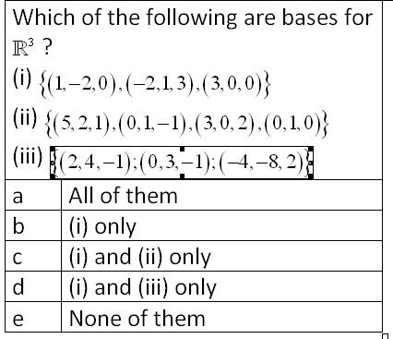
Example

Slide 30
Examples
Find a basis and dimU if U=span{(1,1,1);(1,-1,1);(-1,0,1);(0,-1,1)}
Note that U is a subspace of R³ , so dimU≤dimR³=3
Which of these is a basis of R³: A={(-1,0,3);(3,0,-1)};
B={(1,-1,2);(3,0,1);(1,1,0)};
C={(7,-1,4);(0,0,1);(1,-1,0);(0,1,5)};

Slide 31
Find all x in R such that {(1,1,1,1);(2,3,2,3),(3,4,1,x)} is a linearly independent set

Slide 32
Examples
Find all x in R such that {(1,1,1,1);(2,3,2,3),(3,4,1,x)} is a linearly independent set
Let U=span{(1,2,3);(3,4,5)}. Find m such that (3,5,m) lies in U
For what value of a is the set of vectors S={(1,1,1,1); (3,2,1,5);(2,3,0,a-11)} is linearly dependent?
If (x,y,z) is expressed as a linear combination of vectors v1=(1,1,-1); v2=(1,0,1) and v3=(-1,0,1) then what is the coefficient of v3?

Slide 33
Dot product
If X= [x₁ x₂ … x_{m}]^{T}, Y= [y₁ y₂ … y_{m}]^{T}
We define
X•Y=x₁y₁+x₂y₂+…+x_{m}y_{m}

Slide 34
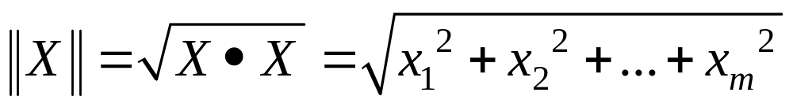
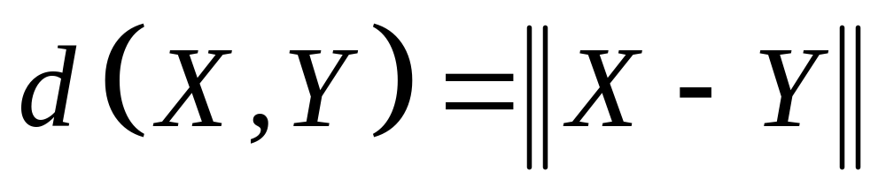
The length of a vector
If X=[x₁ x₂ … x_{m}]^{T} then
A vector with length 1 is called a unit vector
Distance between X and Y defined by

Slide 35
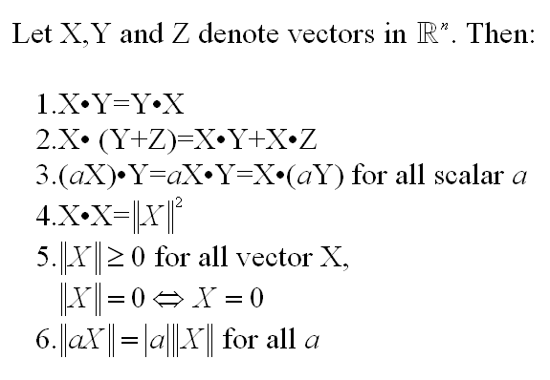
Theorem

Slide 36

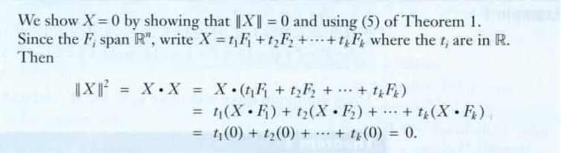
Dot product, Length, and Distance
Example 3
Solution

Slide 37
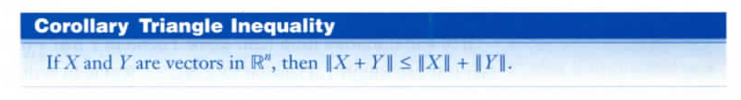
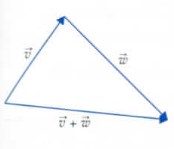

Dot product, Length, and Distance

Slide 38

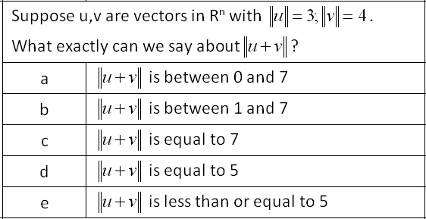
Cauchy Inequality

Slide 39
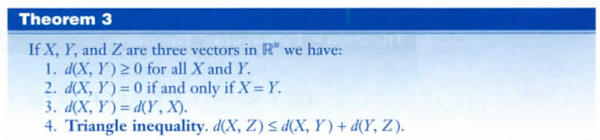
Dot product, Length, and Distance

Slide 40
Orthogonal Set (hệ trực giao)
A set {x₁,x₂,…,x_{m}} is called orthogonal set if x_{i} is not zero vector and x_{i}•x_{j}=0 for all i≠j
For example, {(1,-1);(1,1)} is an orthogonal set in R²
{(1,1,1);(-1,0,1);(0,1,0)} is not orthogonal set but {(-1,0,1);(0,1,0)} is a orthogonal set

Slide 41
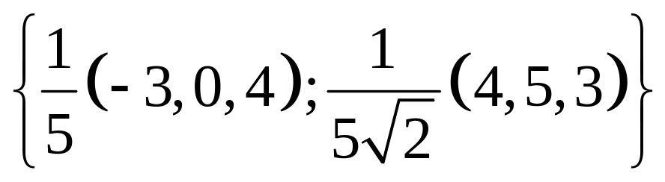
Orthonormal Set (hệ trực chuẩn)
A orthogonal set {x_{i}} is called orthonormal set (hệ trực chuẩn) is x_{i} is unit vector for all i. For example, {(1,0,0);(0,1,0)} is orthonormal
{(-3,0,4);(4,5,3)} is a orthogonal set, not a orthonormal set. However, the set
is orthonormal

Slide 42
Examples
The standard basis of R^{n} {E₁,E₂,…,E_{n}} is orthonormal
If {F₁,F₂,…,F_{k}} is orthogonal then {a₁F₁,a₂F₂,…,a_{k}F_{k}} is also orthogonal for any nonzero scalar a_{i}
Every orthogonal set is a linearly independent set

Slide 43
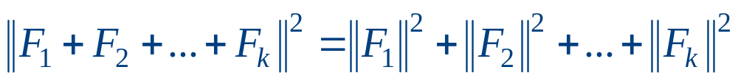
Pythagoras’s Theorem
If {F₁,F₂,…,F_{k}} is orthogonal then

Slide 44
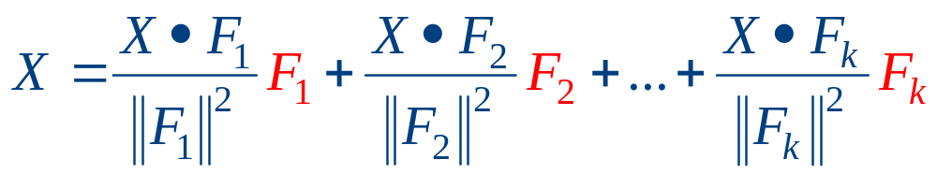

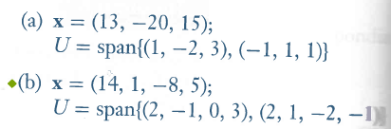
Expansion Theorem
Let {F₁,F₂,…,F_{k}} be a orthogonal basis of a subspace U and X is in U. Then
Notes:
3, 4, 5,6 p. 252

Slide 45
5.4. Rank of a matrix
Hạng của ma trận

Slide 46
Rank of a matrix
If A is carried to row-echelon form then rankA=number of leading 1’s
If A is an mxn matrix then rankA≤min{n,m}
rankA=rank(A^{T})

Slide 47
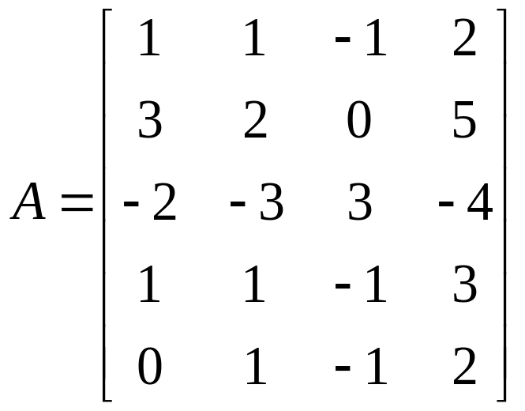
rowA and colA subspaces
rowA=span{rows of matrix A}
colA=span{columns of A}
dim(rowA)=dim(colA)=rankA
For example, find bases of colA and rowA if

Slide 48
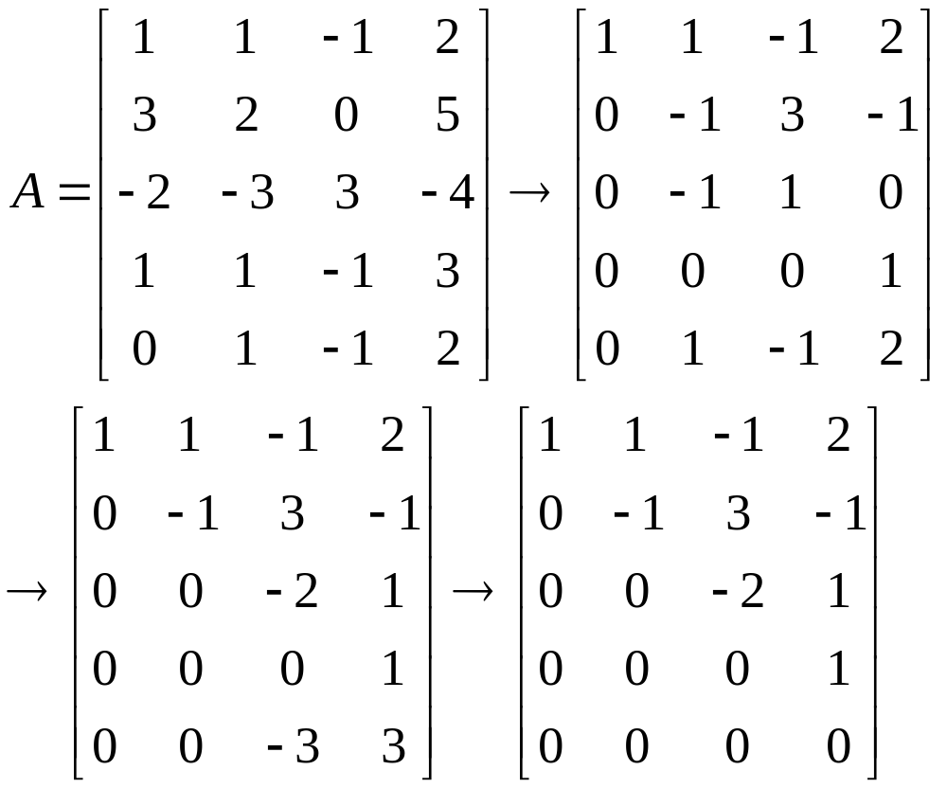
A basis of rowA is {r₁,r₂,r₃,r₄} and dim(rowA)=4
A basis of colA is {c₁,c₂,c₃,c₄} and dim(colA)=4

Slide 49
Theorem
An nxn matrix A is invertible if and only if rankA=n
If an mxn matrix B has rank n then the n columns of B is linearly independent
If A is mxn matrix and m>n then the set of m rows of A is not independent

Slide 50
Theorem
If an mxn matrix A has rank r then
The equation AX=0 has n-r basic solutions X₁,X₂,…,X_{n-r}
{X₁,X₂,…,X_{n-r}} is a basis of nullA
Dim nullA=n-r
imA=colA and
Dim imA=dim colA=rankA=r

Slide 51
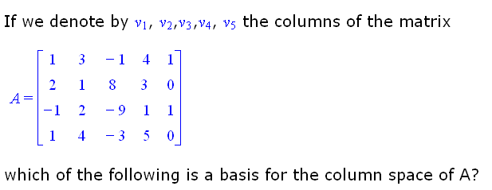

Slide 52
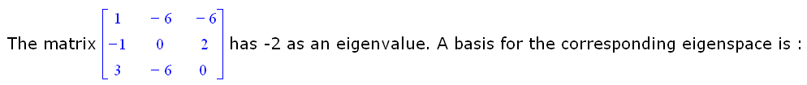

Slide 53
Examples
Find a basis and dimU if:
U=span{(1,-1,2,0);(-2,1,0,1);(-1,0,0,1); (1,0,1,2)}
U=span{(1,-1,3,0);(5,-2,4,3);(-2,0,7,1)}
U=span{(-1,4,3);(3,0,-2);(-6,2,0)}
U={(a,b,c):a+b+c=0}
U={[a b 0]^{T}: a,b in R}

Slide 54
Thanks
Notes:
1,2,7 p.260

